Slide 1
Deletion of Nrf2 induces depressive-like phenotype while Nrf2 activators rescue depressive-like behavior
Bio 792- Molecular Mechanisms of Affect
Ben Onserio

Slide 2
Overall Hypothesis/Theme/Story
Inflammation depression
Nrf2 participates in inflammation
Could Nrf2 play a role in depressive disorders?
Nrf2 deletion in mice
Administration of anti-inflammatory drugs- Rofecoxib, 7,8-DHF, celastrol
Metabolomic, transcriptomic, and morphological analyses

Slide 3
Nuclear factor (erythroid 2-derived)-like(Nrf2)
Nrf2 is a transcription factor that plays a role in cellular defense
against oxidative insult
electrophilic insult
Nrf2 binds to antioxidant response elements (ARE)
located in the promoter regions of genes encoding phase II detoxifying/antioxidant enzymes
related stress-responsive elements
Under normal conditions, Nrf2 is repressed by Keap1

Slide 4
Nuclear factor (erythroid 2-derived)-like(Nrf2)
https://www.mdpi.com/1422-0067/20/16/3856/htm

Slide 5
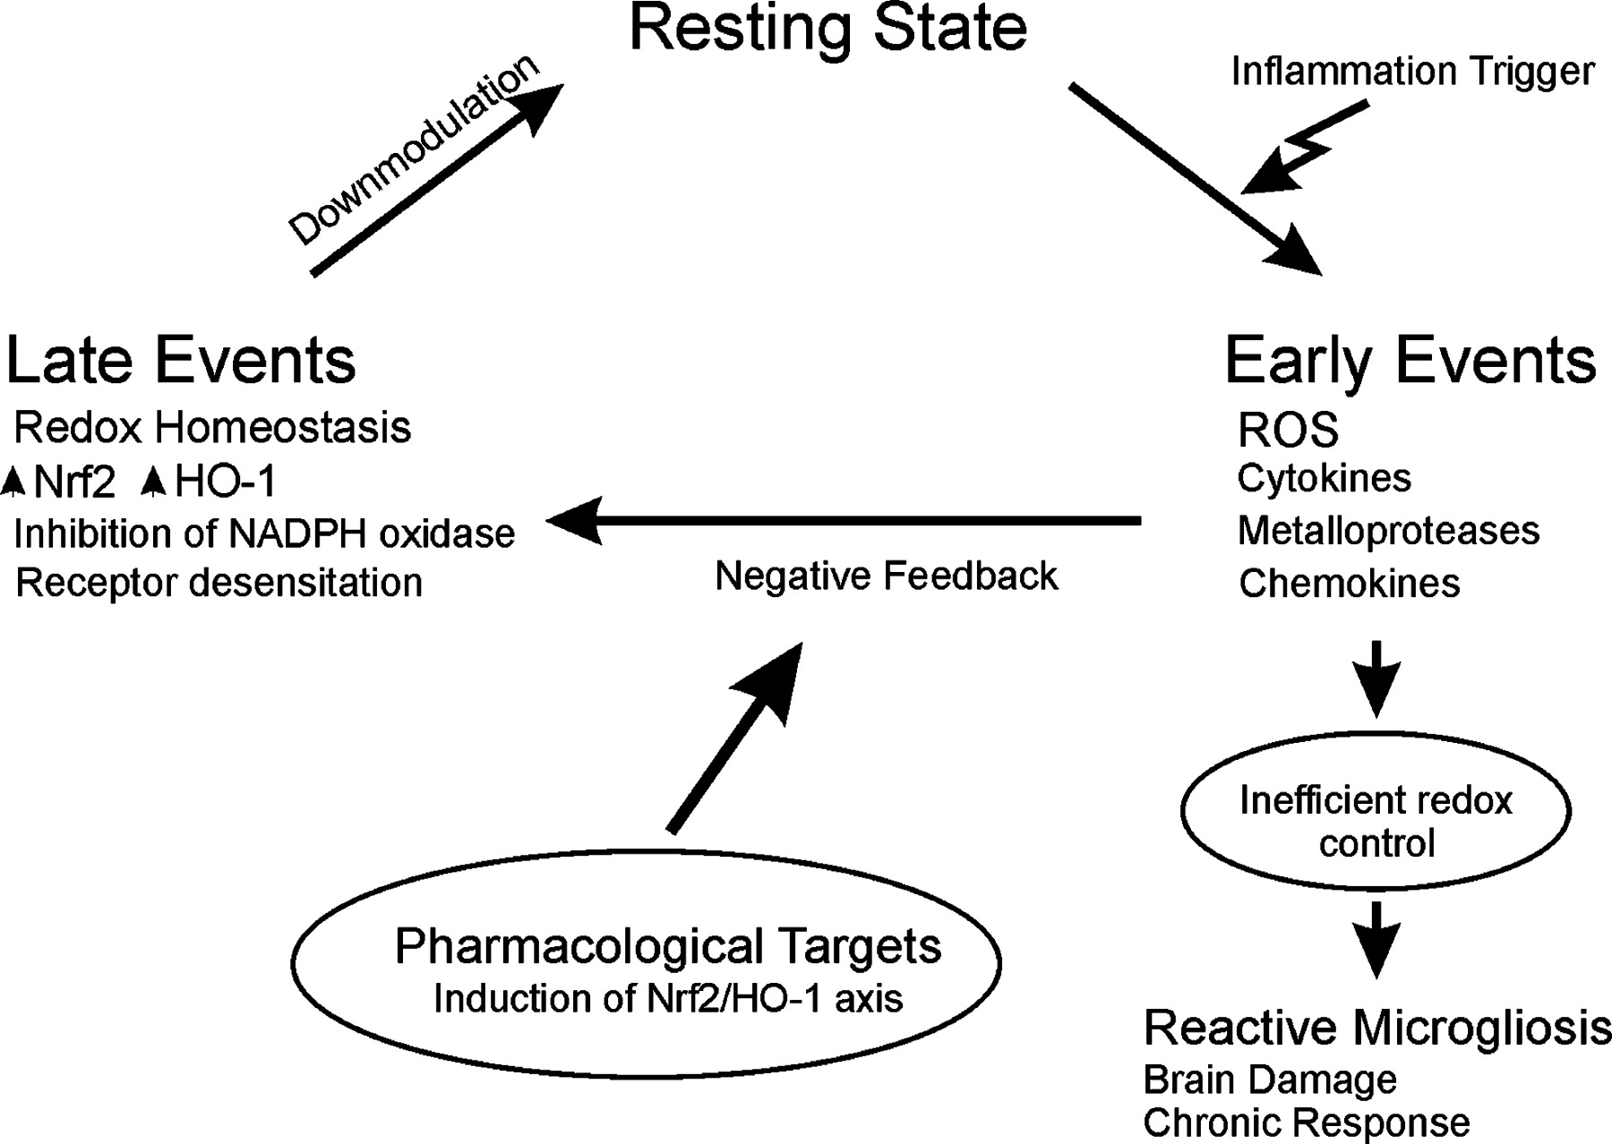
Nuclear factor (erythroid 2-derived)-like(Nrf2)
Nadia G. Innamorato et al. J Immunol 2008;181:680-689

Slide 6
Kelch-like erythroid cell-derived protein with CNC homology(Keap1)
Keap1 is an adaptor protein for degradation of Nrf2
During oxidative stress, Nrf2 is de-repressed and activates the transcription of cytoprotective genes
Keap1-Nrf2 system is involved in attenuating inflammation-associated pathogenesis

Slide 7
Kelch-like erythroid cell-derived protein with CNC homology(Keap1)
Suzuki et al. Current Opinion in Toxicology 2016;29-36

Slide 8
Nrf2 gene deletion leads to alterations in the mobility time in the tail-suspension test (TST)
Immobility time in TST was increased in Nrf2 (-/-) by 60%
indicative of depressive-like behavior

Slide 9
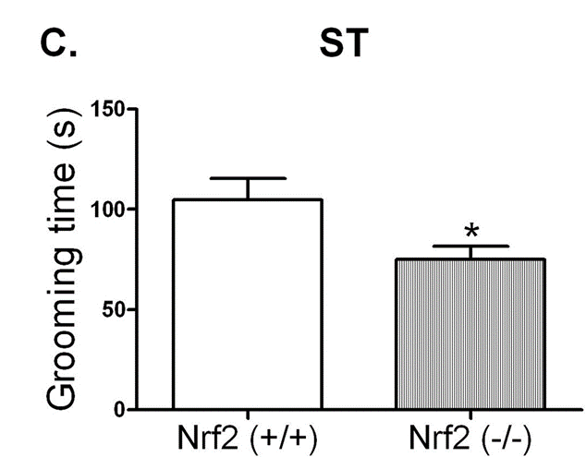
Nrf2 gene deletion leads to alterations in the grooming time in the splash test (ST)
Grooming time in ST was decreased in Nrf2 (-/-) by 30%
indicative of depressive-like behavior

Slide 10
Neurotransmitter levels are altered in Nrf2 (-/-) mice in the prefrontal cortex
Hippocampus

Slide 11
Neurotransmitter levels are altered in Nrf2 (-/-) mice in the prefrontal cortex
Hippocampus

Slide 12
Neurotransmitter levels are altered in Nrf2 (-/-) mice in the prefrontal cortex
Prefrontal cortex

Slide 13
Neurotransmitter levels are altered in Nrf2 (-/-) mice in the prefrontal cortex
Prefrontal cortex

Slide 14
Neurotransmitter levels are altered in Nrf2 (-/-) mice in the prefrontal cortex
Prefrontal cortex

Slide 15
Nrf2 (-/-) mice present modified levels of VEGF and synaptophysin
Prefrontal cortex

Slide 16
Nrf2 (-/-) mice present modified levels of VEGF and synaptophysin
Prefrontal cortex

Slide 17
Nrf2 (-/-) mice present modified levels of VEGF and synaptophysin
Prefrontal cortex

Slide 18
Nrf2 (-/-) mice present modified levels of VEGF and synaptophysin

Slide 19
Nrf2 gene deletion causes retraction of astroglial process in the hippocampus

Slide 20
Nrf2 (-/-) mice exhibit microgliosis in the hippocampus

Slide 21
Nrf2 (-/-) mice exhibit microgliosis in the hippocampus

Slide 22
Rofecoxib reverts depressive-like behaviors exhibited in Nrf2 (-/-) mice
Rofecoxib= a selective COX-2 inhibitor

Slide 23
Rofecoxib reverts depressive-like behaviors exhibited in Nrf2 (-/-) mice

Slide 24
The Nrf2 activator sulforaphane (SFN) induces HO-1, GCLm and BDNF, and prevents LPS-induced depressive-like behavior and iNOS overexpression
Sulforaphane= Nrf2 activator

Slide 25
The Nrf2 activator sulforaphane (SFN) induces HO-1, GCLm and BDNF, and prevents LPS-induced depressive-like behavior and iNOS overexpression

Slide 26
The Nrf2 activator sulforaphane (SFN) induces HO-1, GCLm and BDNF, and prevents LPS-induced depressive-like behavior and iNOS overexpression

Slide 27
The Nrf2 activator sulforaphane (SFN) induces HO-1, GCLm and BDNF, and prevents LPS-induced depressive-like behavior and iNOS overexpression

Slide 28
Summary
Nrf2 is a therapeutic target against brain inflammation
Nrf2 (-/-) mice exhibited depressive-like behavior
altered neurotransmitter levels
altered neuroplasticity markers
microgliosis
Anti-inflammatory treatment of Nrf2 (-/-) mice with Rofecoxib prevented their depressive-like behavior
Induction of Nrf2 by sulforaphane treatment prevented the depressive-like behavior induced by the pro-inflammatory drug LPS

Slide 29
Nrf2 plays a role in SFN’s potentiation of NGF-induced neurite outgrowth
SFN= anti-inflammatory compound/ Nrf2 activator

Slide 30
Nrf2 plays a role in SFN’s potentiation of NGF-induced neurite outgrowth

Slide 31
Treatment with Nrf2 siRNA attenuates NGF-induced neurite outgrowth in PC12 cells

Slide 32
Treatment with Nrf2 siRNA significantly blocks SFN-induced Nrf2 protein expression
SFN can potentiate NGF-induced neurite outgrowth via activation of Nrf2

Slide 33
Reduction of Keap1-Nrf2 signaling in the brain from social defeat stress model of depression
Decreased levels of Keap1 and Nrf2 in the CA3, DG, and PFC may be implicated in the pathophysiology of depression after social defeat stress

Slide 34
Depression-like phenotypes in Nrf2 KO mice
Immobility times in TST of Nrf2 KO mice were significantly higher= show that Nrf2 KO mice have depression-like phenotype

Slide 35
Altered BDNF-TrkB signaling in Nrf2 KO mice
BDNF-TrkB signaling plays a role in depression-like phenotype in rodents

Slide 36
Altered GluA-1 and PSD-95 in Nrf2 KO mice
GluA-1= AMPA receptor 1 marker
PSD-95 = synaptogenesis marker

Slide 37
Elevated Pro-inflammatory cytokines levels in Nrf2 KO mice
Suggesting that Nrf2 KO mice have inflammation

Slide 38
Antidepressant effect of 7,8-dihydroxyflavone(7,8-DHF) in Nrf2 KO mice
7,8-DHF= TrkB agonist

Slide 39
Antidepressant effect of 7,8-dihydroxyflavone(7,8-DHF) in Nrf2 KO mice
A single administration of 7,8-DHF significantly attenuates the decreased ratio of p-TrkB to total TrkB in CA3, DG and PFC of Nrf2 KO mice

Slide 40
Summary
Through Nrf2 activation, SFN can potentiate NGF-induced neurite outgrowth in PC12 cells
Nrf2 activators such as SFN are capable of enhancing neuronal plasticity
Nrf2 and Keap1 proteins show decreased expression in the CA3, DG, and PFC of mice with depressed-like phenotype after repeated social defeat stress
TrkB agonist 7,8-DHF promotes and antidepressant effect in Nrf2 KO mice

Slide 41
Medaka are less social and show more anxiety-like behaviors under winter-like conditions
SC= short day and cool temperature (10-h light/14-h dark; 10 °C)
LW= long day and warm temperature (14-h light/10-h dark; 26 °C)
Time spent in the bottom area of the tank was significantly shorter in medaka under LW conditions

Slide 42
Medaka are less social and show more anxiety-like behaviors under winter-like conditions
Medaka in LW conditions spent more time in the preferential area exhibiting interest in other individuals

Slide 43
Medaka are less social and show more anxiety-like behaviors under winter-like conditions
Number of approaches to the mirror was significantly decreased in SC

Slide 44
Medaka are less social and show more anxiety-like behaviors under winter-like conditions
Medaka kept under LW spent more time in the light area compared to medaka in SC conditions

Slide 45
Brain metabolites show depression-like status in winter-like conditions
bbbbbbbbbbbnnnn
Taurine is a glutamate antagonist
It also has antidepressant activity
Seasonal changes of 68 metabolites out of measured 204 metabolites

Slide 46
Brain metabolites show depression-like status in winter-like conditions
Decreased levels of the antioxidant glutathione, tryptophan and tyrosine in SC
Seasonal changes of 68 metabolites out of measured 204 metabolites

Slide 47
Disruption of circadian rhythms and elevation of inflammatory markers in winter-like conditions
Several differentially expressed genes encoding melanopsin photopigments
OPN4B
OPN4XB
Circadian clock genes
PER2
PER3
CRY2

Slide 48
Disruption of circadian rhythms and elevation of inflammatory markers in winter-like conditions

Slide 49
Disruption of circadian rhythms and elevation of inflammatory markers in winter-like conditions
Upregulation of several inflammatory markers under SC conditions

Slide 50
Disruption of Circadian Rhythms and Elevation of Inflammatory markers in Winter-like Conditions
Upregulation of several inflammatory markers under SC conditions

Slide 51
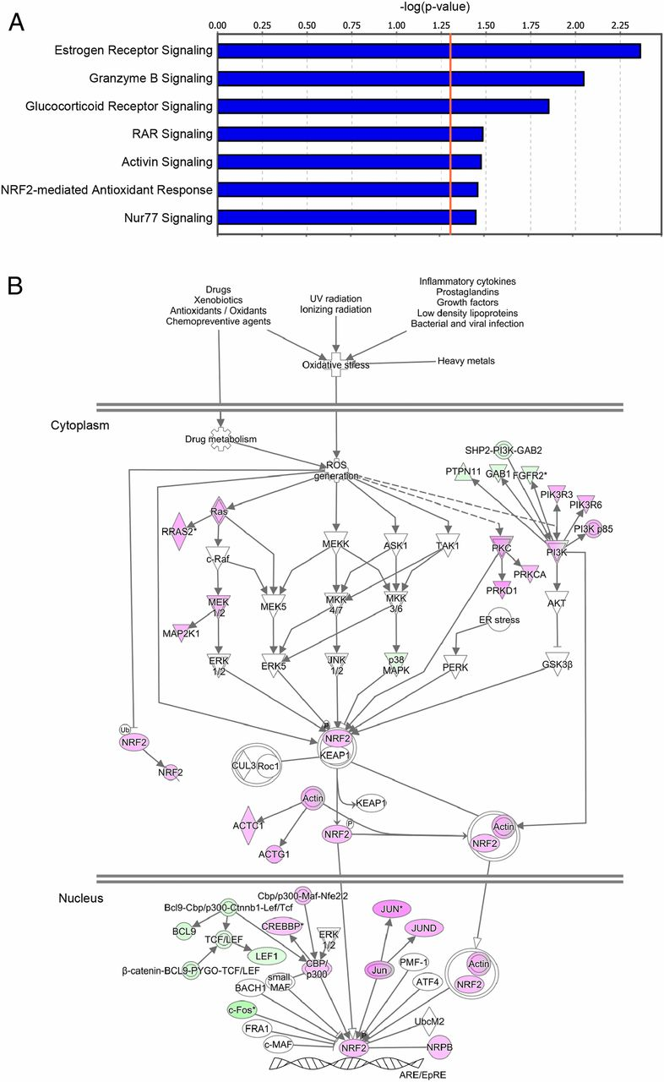
Inactivation of multiple signaling pathways including anti-inflammatory pathway under winter-like conditions
Inactivation of estrogen receptor under winter-like conditions
endogenous estrogen has antidepressive effects
Inactivation of retinoic acid receptor (RAR) and glucocorticoid receptor
involved in modulation of HPA axis

Slide 52
Celastrol exerts anti-inflammatory effects by activating the Nrf2 antioxidant pathway

Slide 53
Dimethyl fumarate rescues winter-like behavior
DMF= Nrf2 activator

Slide 54
Summary
Metabolomic, transcriptomic, and morphological analyses have demonstrated seasonal changes involved depressive-like phenotype
metabolites e.g., neurotransmitters
gene expression e.g., clock genes
neuroplasticity e.g., spine density

